Slide 1
Classifier Performance & Model Comparison
+
Ensemble Classifiers
Prof. Navneet Goyal
BITS, Pilani
Notes:
Dr. Navneet Goyal, BITS,Pilani

Slide 2
Topics
  Classifier Performance Evaluation & Model Comparison
    Holdout Method
    Random Subsampling
    Cross-Validation
    Bootstrap
    Cost-benefit Analysis
    Receiver Operating Characteristic Curve
Notes:
Dr. Navneet Goyal, BITS,Pilani

Slide 3
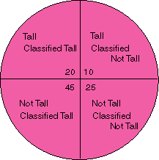
Classification Performance
True Positive
True Negative
False Positive
False Negative
Notes:
Dr. Navneet Goyal, BITS,Pilani

Slide 4
Alternative Metrics
Class imbalance problems
Accuracy measures treat every class as equally important
Not suitable for analyzing skewed data sets, where the rare class is considered more “interesting” than the majority class
For binary classification, rare class is considered as +ve class

Slide 5
Alternative Metrics
 | PREDICTED CLASS
ACTUAL CLASS |  | + | -
 | + | f++ TP | f+- FN
 | - | f-+ FP | f-- TN
TPR (sensitivity,recall) = TP/(TP+FN)
TNR (specificity) = TN/(TN+FP)
FPR = FP/(TN+FP)
FNR = FN/(TP+FN)

Slide 6
Alternative Metrics
Recall & Precision are used when detection of one of the classes is considered more significant
Precision, p = TP/(TP+FP)
Recall, r = TP/(TP+FN)
Higher precision means?
Low FPs!
High Recall means?
Low FNs!
Model that classifies everything as +ve?
Perfect Recall!
Poor Precision!
Maximizing both Recall & Precision is key challenge in classification

Slide 7
Alternative Metrics
F1 measure: summarization of precision & recall
F1 = 2rp/(r+p)
Harmonic mean between precision & recall
Harmonic means tends to be closer to the smaller of the two numbers
How can you interpret a high value of F1?
Both recall & precision are reasonably high

Slide 8
Operating Characteristic Curve
OC Curve (operating characteristic curve) or ROC curve (receiver operating characteristic curve)
Developed in 1950s for signal detection theory to analyze noisy signals
  Characterize the trade-off between positive hits and false alarms
Shows relationship between FPs and TPs
Originally used in communications area to examine false alarm rates
Used in IR to examine fallout (%age of retrieved that are not relevant) versus recall (%age of retrieved that are relevant)
Notes:
Dr. Navneet Goyal, BITS,Pilani

Slide 9
ROC (Receiver Operating Characteristic)
Developed in 1950s for signal detection theory to analyze noisy signals
  Characterize the trade-off between positive hits and false alarms
ROC curve plots TP (on the y-axis) against FP (on the x-axis)
Performance of each classifier represented as a point on the ROC curve
  changing the threshold of algorithm, sample distribution or cost matrix changes the location of the point

Slide 10
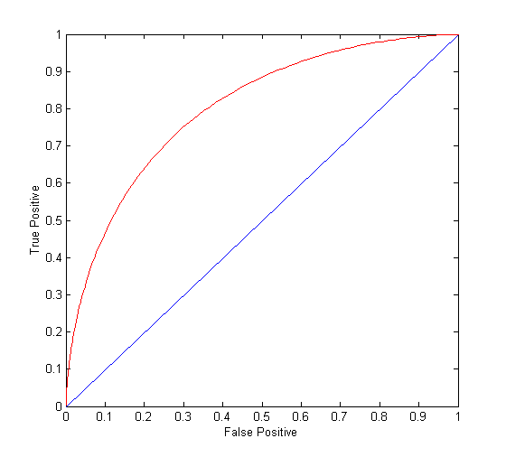
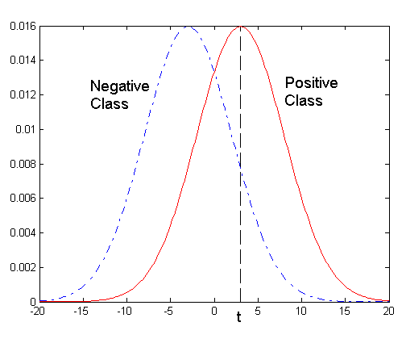
ROC Curve
- 1-dimensional data set containing 2 classes (positive and negative)
- any points located at x > t is classified as positive
At threshold t:
TP=0.5, FN=0.5, FP=0.12, FN=0.88
Notes:
Dr. Navneet Goyal, BITS,Pilani

Slide 11
ROC Curve
(TP,FP):
(0,0): declare everything
to be negative class
(1,1): declare everything
to be positive class
(1,0): ideal
Diagonal line:
  Random guessing
  Below diagonal line:
    prediction is opposite of the true class

Slide 12
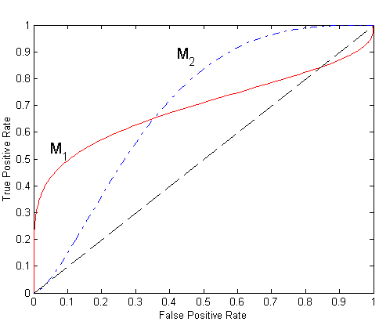
Using ROC for Model Comparison
No model consistently outperform the other
  M₁ is better for small FPR
  M₂ is better for large FPR
Area Under the ROC curve
  Ideal:
    Area = 1
  Random guess:
    Area = 0.5

Slide 13
How to Construct an ROC curve?
Use classifier that produces posterior probability for each test instance P(+|A)
Sort the instances according to P(+|A) in decreasing order
Apply threshold at each unique value of P(+|A)
Count the number of TP, FP,
TN, FN at each threshold
TP rate, TPR = TP/(TP+FN)
FP rate, FPR = FP/(FP + TN)
Instance | P(+|A) | True Class
1 | 0.95 | +
2 | 0.93 | +
3 | 0.87 | -
4 | 0.85 | -
5 | 0.85 | -
6 | 0.85 | +
7 | 0.76 | -
8 | 0.53 | +
9 | 0.43 | -
10 | 0.25 | +

Slide 14
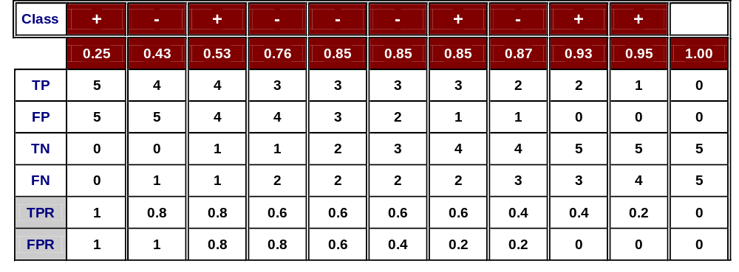
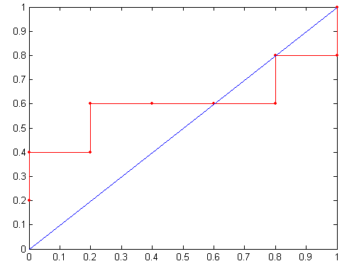
How to Construct an ROC curve?
Threshold >=
ROC Curve:

Slide 15
Test of Significance
Given two models:
  Model M1: accuracy = 85%, tested on 30 instances
  Model M2: accuracy = 75%, tested on 5000 instances
Can we say M1 is better than M2?
  How much confidence can we place on accuracy of M1 and M2?
  Can the difference in performance measure be explained as a result of random fluctuations in the test set?

Slide 16
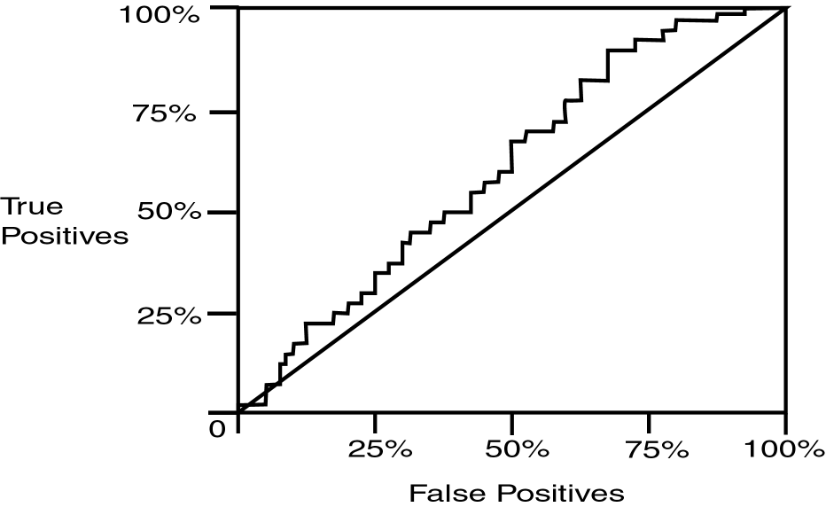
Operating Characteristic Curve
Notes:
Dr. Navneet Goyal, BITS,Pilani

Slide 17
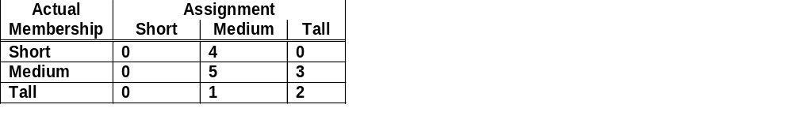
Confusion Matrix Example
Using height data example with Output1 correct and Output2 actual assignment
Notes:
Dr. Navneet Goyal, BITS,Pilani

Slide 18
Classifier Accuracy Measures
Accuracy of a classifier on a given test set is the %age of test set tuples that are correctly classified by the classifier
In pattern recognition literature, it is called ‘recognition rate’
Reflects how well the classifier recognizes tuples of various classes
Error rate or misclassification rate of a classifier M is 1 – Acc(M), where Acc(M) is the accuracy of M
Notes:
Dr. Navneet Goyal, BITS,Pilani

Slide 19
Alternative Measures
Example: we trained a classifier to classify medical data tuples as either ‘cancer’ or ‘not_ cancer’
90% accuracy rate – sounds good
What if only 3-4% of traning set tuples are actually ‘cancer’?
Classifier could be correctly labeling only the not_cancer tuples
How well the classifier recognizes ‘cancer’ tuples (+ tuples) and how well it can recognize not_cancer tuples (- tuples)?
USE Sensitivity & Specificity respectively
Notes:
Dr. Navneet Goyal, BITS,Pilani

Slide 20
Alternative Measures
Sensitivity (True + or recognition)
Specificity (False +)
In addition, we may use ‘precision’ to assess the %age of tuples labeled as ‘cancer’ that actually are cancer tuples
Sensitivity = #(True +)/+
Specificity = #(True -)/-
Precision = #(True +)/(#(True +) + #(False +))
where #(True +) is the no. of true positives (cancer tuples that were correctly classified)
+ is the no. of ‘cancer’ tuples
#(True -) is the no. of true negatives (not_cancer tuples that were correctly classified as such)
- is the no. of ‘not_cancer’ tuples
#(False +) is the no. of false positives (‘not_cancer’ incorrectly labelled as ‘cancer’)
Notes:
Dr. Navneet Goyal, BITS,Pilani

Slide 21
Alternative Measures
It can be shown that Accuracy is a function of Sensitivity and Specificity
Accuracy = Sensitivity ((pos)/(pos+neg) )
+ Specoficity ((neg)/(pos+neg) )
Other cases where ‘accuracy’ not appropriate?
Assumption: each tuples belongs to only one class?
Rather than returning a class label, it is useful to return a probability class distribution
A classification is considered correct if it assigns a tuple to first or the second most probable class
Notes:
Dr. Navneet Goyal, BITS,Pilani

Slide 22
Class Imbalance Problem
Data sets with skewed class distributions are common in real life applications
Defective products in an assembly lines
Fraudulent credit card transactions are outnumbered by legitimate transactions
Malicious attacks on web sites
In both cases, there are disproportionate no. of instances that belong to different classes
Six-sigma principle: 4 defects in 1m products
1% fraudulent transactions
Imbalance causes a no. of problems to existing classification algorithms
Accuracy measures not appropriate!!
Notes:
Dr. Navneet Goyal, BITS,Pilani

Slide 23
Metrics for Performance Evaluation
Focus on the predictive capability of a model
  Rather than how fast it takes to classify or build models, scalability, etc.
Confusion Matrix:
 | PREDICTED CLASS
ACTUAL CLASS |  | Class=Yes | Class=No
 | Class=Yes | a | b
 | Class=No | c | d
a: TP (true positive)
b: FN (false negative)
c: FP (false positive)
d: TN (true negative)

Slide 24
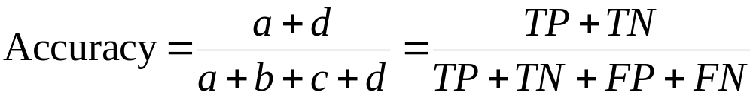
Metrics for Performance Evaluation…
Most widely-used metric:
 | PREDICTED CLASS
ACTUAL CLASS |  | Class=Yes | Class=No
 | Class=Yes | a (TP) | b (FN)
 | Class=No | c (FP) | d (TN)

Slide 25
Limitation of Accuracy
Consider a 2-class problem
  Number of Class 0 examples = 9990
  Number of Class 1 examples = 10
If model predicts everything to be class 0, accuracy is 9990/10000 = 99.9 %
  Accuracy is misleading because model does not detect any class 1 example

Slide 26
Cost Matrix
 | PREDICTED CLASS
ACTUAL CLASS | C(i|j) | Class=Yes | Class=No
 | Class=Yes | C(Yes|Yes) | C(No|Yes)
 | Class=No | C(Yes|No) | C(No|No)
C(i|j): Cost of misclassifying class j example as class i

Slide 27
Computing Cost of Classification
Cost Matrix | PREDICTED CLASS
ACTUAL CLASS | C(i|j) | + | -
 | + | -1 | 100
 | - | 1 | 0
Model M₁ | PREDICTED CLASS
ACTUAL CLASS |  | + | -
 | + | 150 | 40
 | - | 60 | 250
Model M₂ | PREDICTED CLASS
ACTUAL CLASS |  | + | -
 | + | 250 | 45
 | - | 5 | 200
Accuracy = 80%
Cost = 150x-1+60x1+40x100 =3910
Accuracy = 90%
Cost = 250x-1+5x1+45x100 =4255

Slide 28
Cost vs Accuracy
Accuracy is proportional to cost if
1. C(Yes|No)=C(No|Yes) = q
2. C(Yes|Yes)=C(No|No) = p
Count | PREDICTED CLASS
ACTUAL CLASS |  | Class=Yes | Class=No
 | Class=Yes | a | b
 | Class=No | c | d
N = a + b + c + d
Accuracy = (a + d)/N
Cost = p (a + d) + q (b + c)
= p (a + d) + q (N – a – d)
= q N – (q – p)(a + d)
= N [q – (q-p) × Accuracy]
Cost | PREDICTED CLASS
ACTUAL CLASS |  | Class=Yes | Class=No
 | Class=Yes | p | q
 | Class=No | q | p
Notes:
Dr. Navneet Goyal, BITS,Pilani

Slide 29
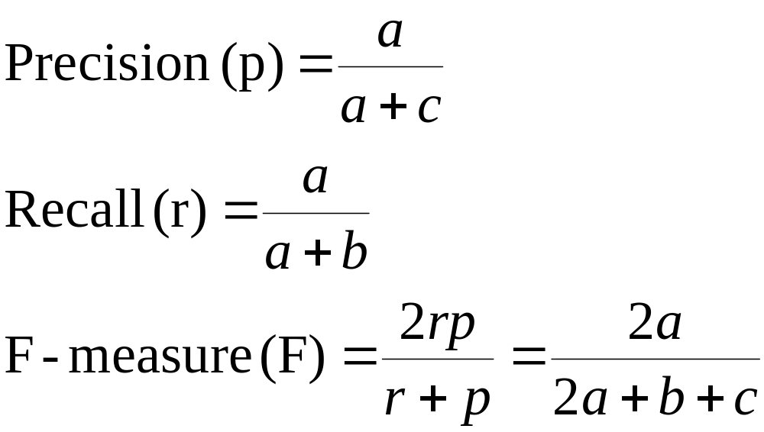
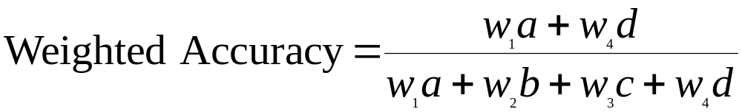
Cost-Sensitive Measures
Precision is biased towards C(Yes|Yes) & C(Yes|No)
Recall is biased towards C(Yes|Yes) & C(No|Yes)
F-measure is biased towards all except C(No|No)

Slide 30
Evaluating Classifier Performance
Holdout
Random Sub-Sampling
Cross Validation
Bootstrap
Notes:
Dr. Navneet Goyal, BITS,Pilani

Slide 31
Holdout Method
Given data randomly partitioned in to a training set and a test set
2/3 training set
1/3 test set
Training set is used to derive the model
Accuracy is tested using the test set
Estimate is pessimistic since only a part of the given data is used for building the model
Sensitive to the choice of training and test sets
Confidence interval is large for varying sizes of training and test sets
Over representation in one leads to under representation in the other & vice versa
Notes:
Dr. Navneet Goyal, BITS,Pilani

Slide 32
Random Subsampling
Variation of the holdout method
Holdout method is repeated k times
Overall accuracy is the average of the accuracies from each iteration
Less sensitive to the choice of training and test data sets unlike the hold out method
No control over the no. of times each record is used for training and testing
Notes:
Dr. Navneet Goyal, BITS,Pilani

Slide 33
Cross-validation
k-fold cross validation
Randomly partition data into k mutually exclusive subsets or ‘folds’ D1, D2, …, Dk
Approximately equal size
Training and testing is performed k times
In iteration i, the partition Di is reserved for testing, and the remaining k-1 subsets are used to train the model
Unlike holdout and random sub-sampling methods, each sample is used the same number of times for training and once for testing
Accuracy = overall no. of correct classifications/total no. of tuples in initial data
LEAVE ONE OUT (k=N) – each test set contains only 1 record.
  Test set mutually exclusive and effectively cover entire data set
  Computationally expensive
Notes:
Dr. Navneet Goyal, BITS,Pilani

Slide 34
Bootstrap
Samples the given training tuples uniformly with replacement
Each time a tuple is selected , it is equally likely be selected again and readded to the training set
You are allowed to select the same tuple more than once
Several bootstrap methods
Most common is .632 bootstrap
Data set of d tuples
The Set is sampled d times, with replacement, resulting in a bootstrap sample or training set of d samples
Notes:
Dr. Navneet Goyal, BITS,Pilani

Slide 35
Bootstrap
Likely that some of the original data tuples will occur more than once in this sample
The tuples that did not make it to the training set form the test set
Try this out several times
On an average, 63.2% of tuples will end up in the bootstrap, and the remaining 36.8% will form the test set
Where from this 0.632 come????
Prob. that a record is chosen by bootstrap is
1-(1-1/N)^{N} when N➔∞ is 1-1/e = 0.632
Notes:
Dr. Navneet Goyal, BITS,Pilani

Slide 36
Ensemble Classifiers
Prof. Navneet Goyal

Slide 37
Ensemble Classifiers
Introduction & Motivation
Construction of Ensemble Classifiers
  Boosting (Ada Boost)
  Bagging
  Random Forests
Empirical Comparison

Slide 38
Introduction & Motivation
Suppose that you are a patient with a set of symptoms
Instead of taking opinion of just one doctor (classifier), you decide to take opinion of a few doctors!
Is this a good idea? Indeed it is.
Consult many doctors and then based on their diagnosis; you can get a fairly accurate idea of the diagnosis.
Majority voting - ‘bagging’
More weightage to the opinion of some ‘good’ (accurate) doctors - ‘boosting’
In bagging, you give equal weightage to all classifiers, whereas in boosting you give weightage according to the accuracy of the classifier.

Slide 39
Ensemble Methods
Construct a set of classifiers from the training data
Predict class label of previously unseen records by aggregating predictions made by multiple classifiers

Slide 40
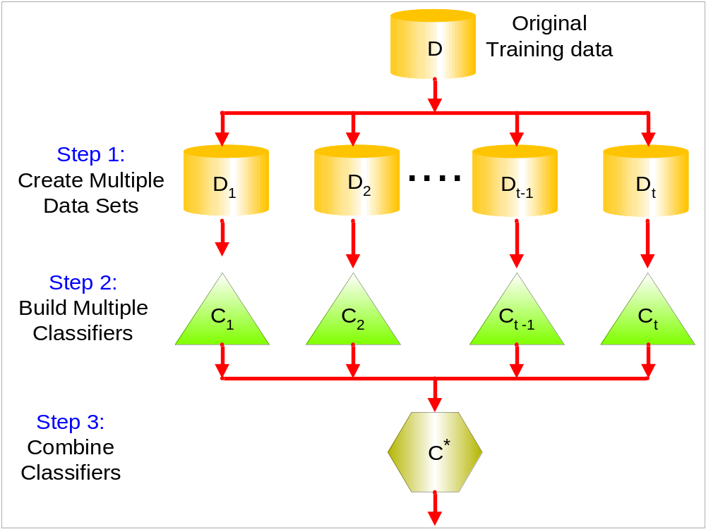
General Idea
Figure taken from Tan et. al. book “Introduction to Data Mining”

Slide 41
Ensemble Classifiers (EC)
An ensemble classifier constructs a set of ‘base classifiers’ from the training data
Methods for constructing an EC
  Manipulating training set
  Manipulating input features
  Manipulating class labels
  Manipulating learning algorithms

Slide 42
Ensemble Classifiers (EC)
Manipulating training set
  Multiple training sets are created by resampling the data according to some sampling distribution
  Sampling distribution determines how likely it is that an example will be selected for training – may vary from one trial to another
  Classifier is built from each training set using a paritcular learning algorithm
  Examples: Bagging & Boosting

Slide 43
Ensemble Classifiers (EC)
Manipulating input features
  Subset of input features chosen to form each training set
  Subset can be chosen randomly or based on inputs given by Domain Experts
  Good for data that has redundant features
  Random Forest is an example which uses DT as its base classifierss

Slide 44
Ensemble Classifiers (EC)
Manipulating class labels
  When no. of classes is sufficiently large
  Training data is transformed into a binary class problem by randomly partitioning the class labels into 2 disjoint subsets, A0 & A1
  Re-labelled examples are used to train a base classifier
  By repeating the class labeling and model building steps several times, and ensemble of base classifiers is obtained
  How a new tuple is classified?
  Example – error correcting output codings (pp 307)

Slide 45
Ensemble Classifiers (EC)
Manipulating learning algorithm
  Learning algorithms can be manipulated in such a way that applying the algorithm several times on the same training data may result in different models
  Example – ANN can produce different models by changing network topology or the initial weights of links between neurons
  Example – ensemble of DTs can be constructed by introducing randomness into the tree growing procedure – instrad of choosing the best split attribute at each node, we randomly choose one of the top k attributes

Slide 46
Ensemble Classifiers (EC)
First 3 approaches are generic – can be applied to any classifier
Fourth approach depends on the type of classifier used
Base classifiers can be generated sequentially or in parallel

Slide 47
Ensemble Classifiers
Ensemble methods work better with ‘unstable classifiers’
Classifiers that are sensitive to minor perturbations in the training set
Examples:
  Decision trees
  Rule-based
  Artificial neural networks

Slide 48
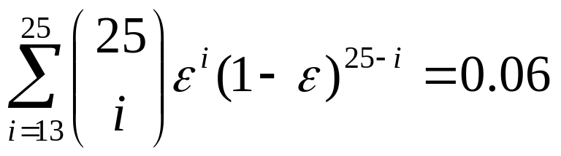
Why does it work?
Suppose there are 25 base classifiers
  Each classifier has error rate, ε = 0.35
  Assume classifiers are independent
  Probability that the ensemble classifier makes a wrong prediction:
  CHK out yourself if it is correct!!
Example taken from Tan et. al. book “Introduction to Data Mining”

Slide 49
Examples of Ensemble Methods
How to generate an ensemble of classifiers?
  Bagging
  Boosting
  Random Forests

Slide 50
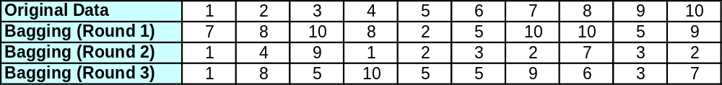
Bagging
Also known as bootstrap aggregation
Sampling uniformly with replacement
Build classifier on each bootstrap sample
0.632 bootstrap
Each bootstrap sample Di contains approx. 63.2% of the original training data
Remaining (36.8%) are used as test set
Example taken from Tan et. al. book “Introduction to Data Mining”

Slide 51
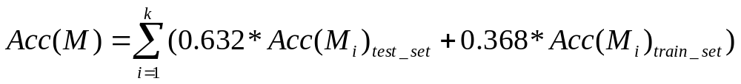
Bagging
Accuracy of bagging:
Works well for small data sets
Example:
X | 0.1 | 0.2 | 0.3 | 0.4 | 0.5 | 0.6 | 0.7 | 0.8 | 0.9 | 1.0
y | 1 | 1 | 1 | -1 | -1 | -1 | -1 | 1 | 1 | 1
Actual Class labels
Example taken from Tan et. al. book “Introduction to Data Mining”

Slide 52
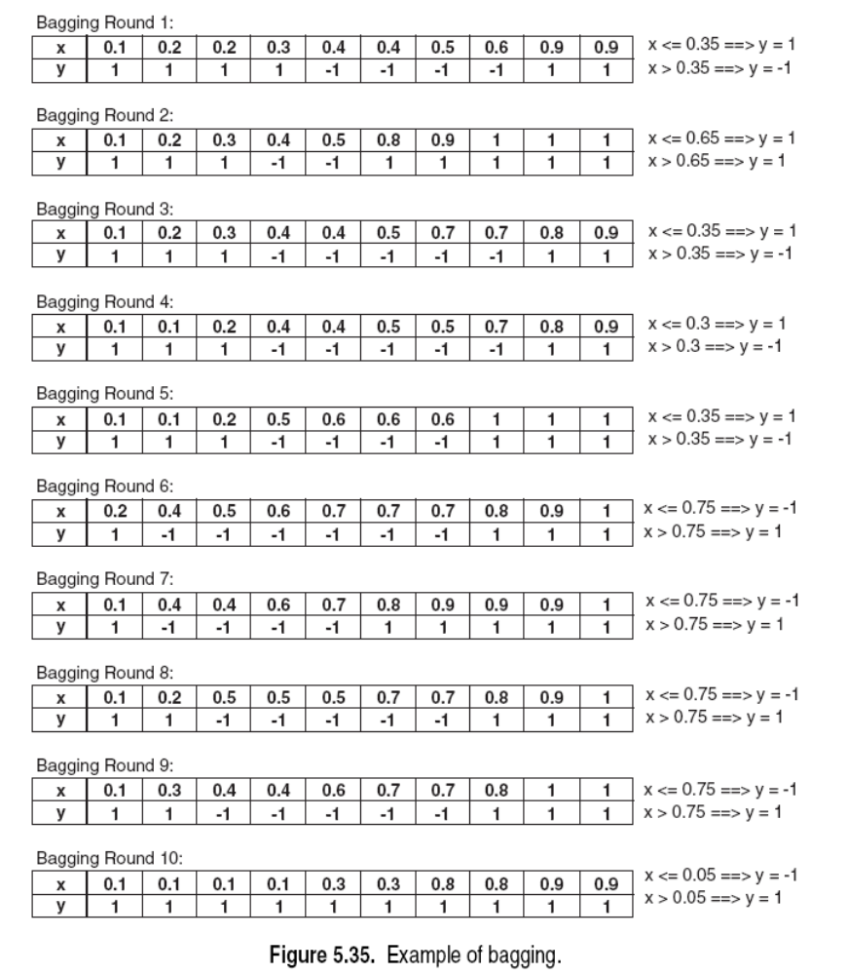
Bagging
Decision Stump
Single level decision binary tree
Entropy – x<=0.35 or x<=0.75
Accuracy at most 70%
Actual Class labels
Example taken from Tan et. al. book “Introduction to Data Mining”

Slide 53
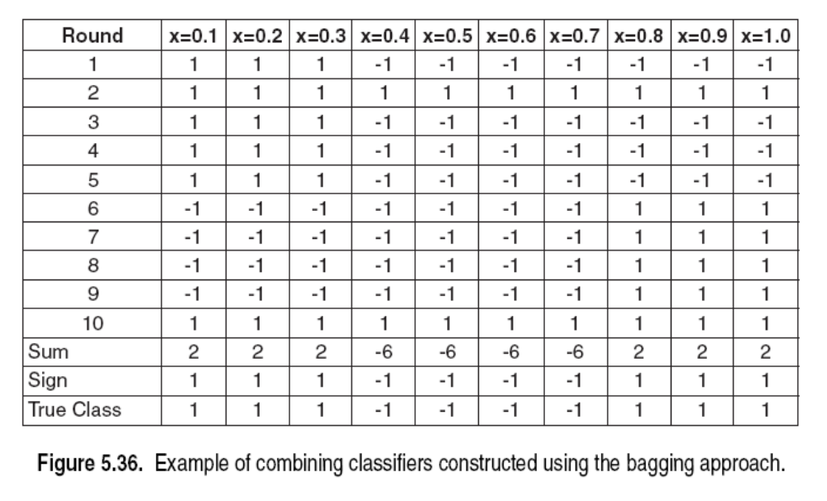
Bagging
Accuracy of ensemble classifier: 100% ☺
Example taken from Tan et. al. book “Introduction to Data Mining”

Slide 54
Bagging- Final Points
Works well if the base classifiers are unstable
Increased accuracy because it reduces the variance of the individual classifier
Does not focus on any particular instance of the training data
Therefore, less susceptible to model over-fitting when applied to noisy data
What if we want to focus on a particular instances of training data?

Slide 55
Boosting
An iterative procedure to adaptively change distribution of training data by focusing more on previously misclassified records
  Initially, all N records are assigned equal weights
  Unlike bagging, weights may change at the end of a boosting round

Slide 56
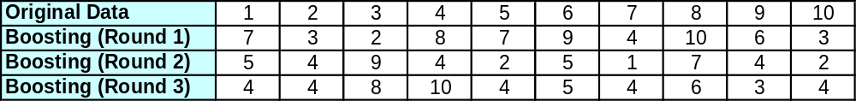
Boosting
Records that are wrongly classified will have their weights increased
Records that are classified correctly will have their weights decreased
Example 4 is hard to classify
Its weight is increased, therefore it is more likely to be chosen again in subsequent rounds
Example taken from Tan et. al. book “Introduction to Data Mining”

Slide 57
Boosting
Equal weights are assigned to each training tuple (1/d for round 1)
After a classifier M_{i} is learned, the weights are adjusted to allow the subsequent classifier M_{i+1} to “pay more attention” to tuples that were misclassified by M_{i}.
Final boosted classifier M* combines the votes of each individual classifier
Weight of each classifier’s vote is a function of its accuracy
Adaboost – popular boosting algorithm

Slide 58
Adaboost
Input:
  Training set D containing d tuples
  k rounds
  A classification learning scheme
Output:
  A composite model

Slide 59
Adaboost
Data set D containing d class-labeled tuples (X1,y1), (X2,y2), (X3,y3),….(Xd,yd)
Initially assign equal weight 1/d to each tuple
To generate k base classifiers, we need k rounds or iterations
Round i, tuples from D are sampled with replacement , to form Di (size d)
Each tuple’s chance of being selected depends on its weight

Slide 60
Adaboost
Base classifier Mi, is derived from training tuples of Di
Error of Mi is tested using Di
Weights of training tuples are adjusted depending on how they were classified
  Correctly classified: Decrease weight
  Incorrectly classified: Increase weight
Weight of a tuple indicates how hard it is to classify it (directly proportional)

Slide 61
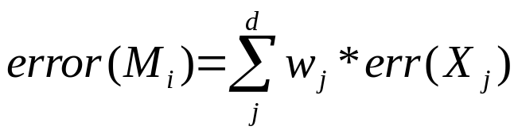
Adaboost
Some classifiers may be better at classifying some “hard” tuples than others
We finally have a series of classifiers that complement each other!
Error rate of model Mi:
where err(Xj) is the misclassification error for Xj(=1)
If classifier error exceeds 0.5, we abandon it
Try again with a new Di and a new Mi derived from it

Slide 62
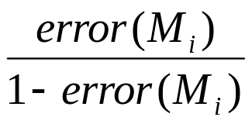
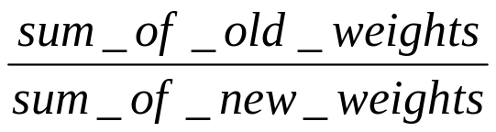
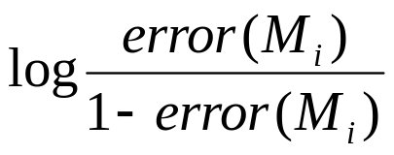
Adaboost
error (Mi) affects how the weights of training tuples are updated
If a tuple is correctly classified in round i, its weight is multiplied by
Adjust weights of all correctly classified tuples
Now weights of all tuples (including the misclassified tuples) are normalized
Normalization factor =
Weight of a classifier Mi’s weight is

Slide 63
Adaboost
The lower a classifier error rate, the more accurate it is, and therefore, the higher its weight for voting should be
Weight of a classifier Mi’s vote is
For each class c, sum the weights of each classifier that assigned class c to X (unseen tuple)
The class with the highest sum is the WINNER!

Slide 64
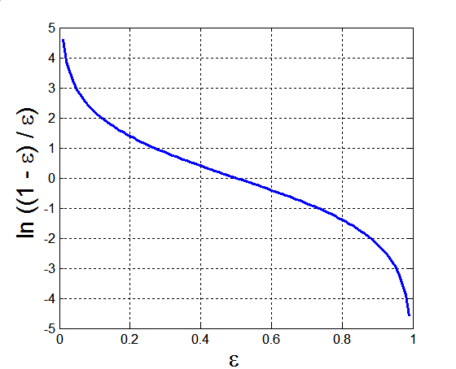
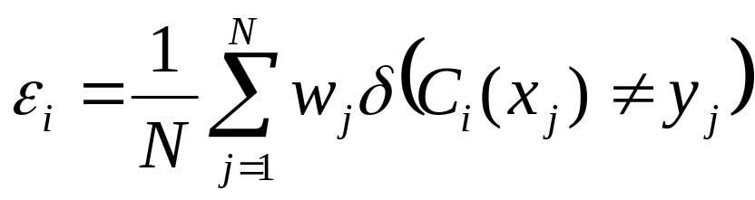
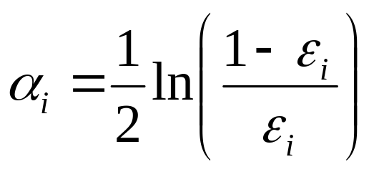
Example: AdaBoost
Base classifiers: C₁, C₂, …, C_{T}
Error rate:
Importance of a classifier:

Slide 65
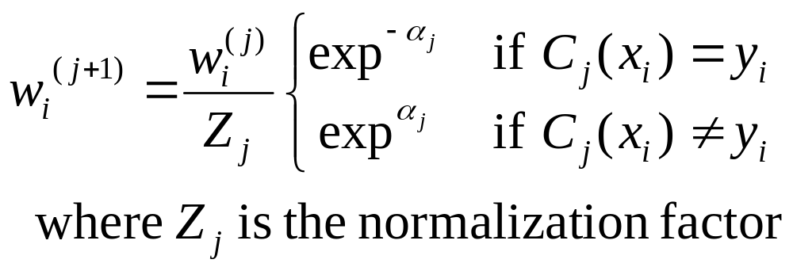
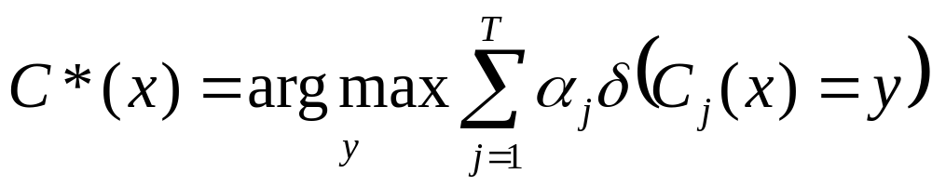
Example: AdaBoost
Weight update:
If any intermediate rounds produce error rate higher than 50%, the weights are reverted back to 1/n and the re-sampling procedure is repeated
Classification:

Slide 66
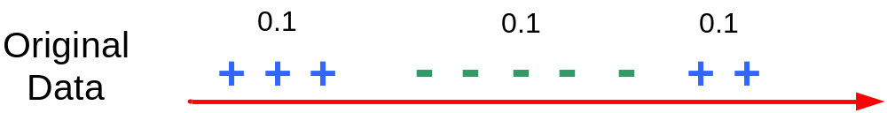
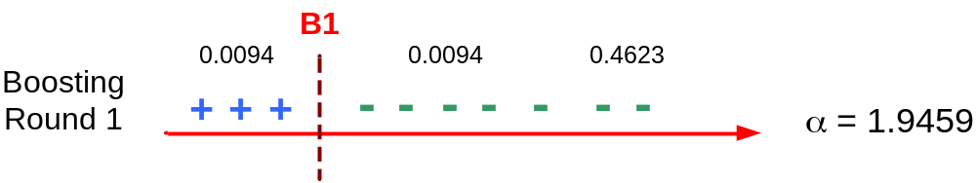
Illustrating AdaBoost
Initial weights for each data point
Data points for training

Slide 67
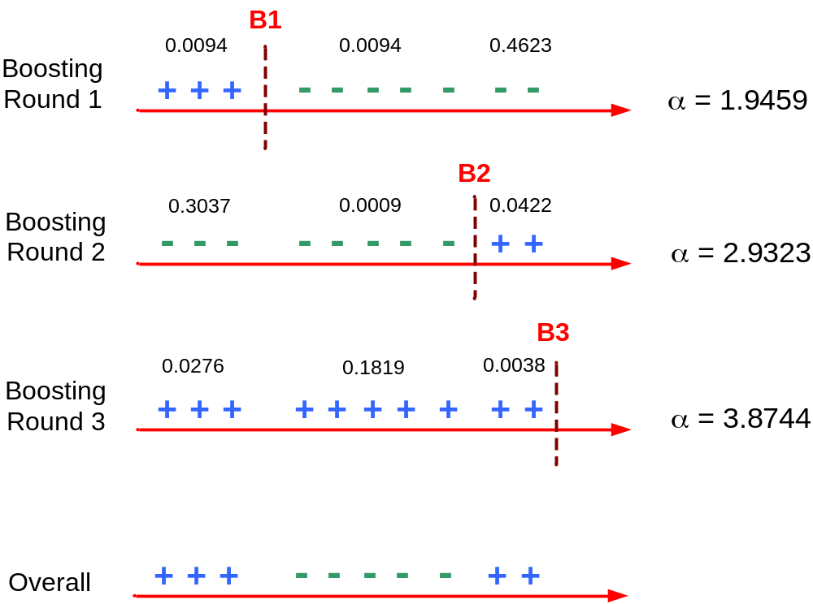
Illustrating AdaBoost

Slide 68
Random Forests
Ensemble method specifically designed for decision tree classifiers
Random Forests grows many classification trees (that is why the name!)
Ensemble of unpruned decision trees
Each base classifier classifies a “new” vector
Forest chooses the classification having the most votes (over all the trees in the forest)

Slide 69
Random Forests
Introduce two sources of randomness: “Bagging” and “Random input vectors”
  Each tree is grown using a bootstrap sample of training data
  At each node, best split is chosen from random sample of m_{try} variables instead of all variables

Slide 70
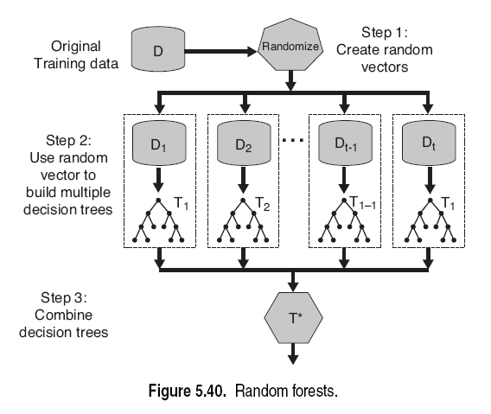
Random Forests

Slide 71
Random Forest Algorithm
M input variables, a number m<<M is specified such that at each node, m variables are selected at random out of the M and the best split on these m is used to split the node.
m is held constant during the forest growing
Each tree is grown to the largest extent possible
There is no pruning
Bagging using decision trees is a special case of random forests when
m=M

Slide 72

Random Forest Algorithm
Out-of-bag (OOB) error
Good accuracy without over-fitting
Fast algorithm (can be faster than growing/pruning a single tree); easily parallelized
Handle high dimensional data without much problem
Only one tuning parameter m_{try} = , usually not sensitive to it

